Slide 1





Byte By Byte
Your central hub for your day to day

Slide 2
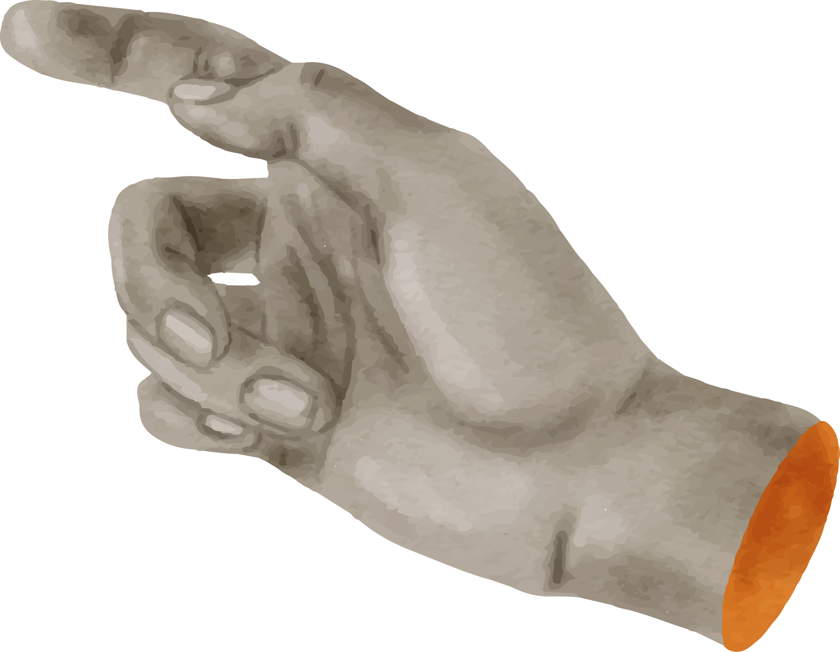


TABLE OF CONTENTS
01
02
The Problem
The Solution
03
04
Impact
Demo

Slide 3



The Problem

Slide 4

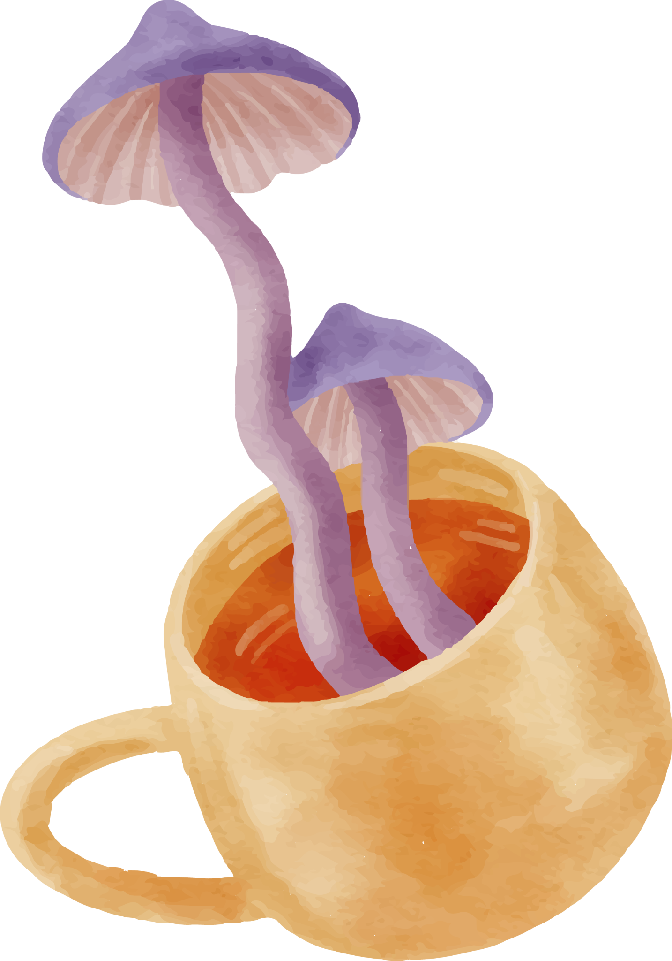
97,000
1,000
Fitness and meal apps
Mood and Menstrual trackers

Slide 5

1 App
To Rule them all

Slide 6



The Solution
Easy to read
01
02
React Native
03
04
Custom DB
Easy to understand
05
06
Private
Expo

Slide 7


The Impact
Less Clutter
Maximizes your time
Has your privacy in mind

Slide 8



Demo

